Slide 1
What are the factors that influence flight delays in reaching their destination?
Presented by: Dor Pitusi

Slide 2
BackGround
What are the primary factors contributing to flight delays and cacellations?
Airport Operation
Weather Conditions
Airlines Performance
How do different airports perform in terms of flight volume, delay frequency, and peak congestion periods throughout the year?
How does weather, including temperature, Wind strength, visibility and precipitation affect delays, and do certain weather patterns correlate with increased flight disruptions?
How do different airlines compare in terms of delays and cancellations?
What operational factors within the airlines (destinations, scheduling) influence delay rates?

Slide 3

Methodology & Research Focus
1
Data Preparation
2
Data Aggregation
3
Checked data quality for the 2013 dataset, addressing missing or inconsistent values. Standardized formats for consistency (numeric fields, airport\airlines names). The dataset is specifically focused on airports in New York.
Group data by origin, destination, and airline, with an emphasis on New York – based airports, to analyze flight counts and delay patterns. Calculated average departure and arrival delays for each route and airline.
Insights Extraction
Identified high – traffic routes and airlines with significant delays, particularly in New York airports. Analyzed specific causes of delays (weather, operational constraints).

Slide 4
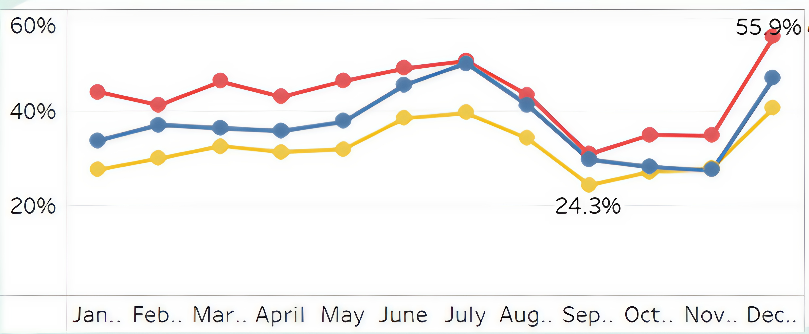
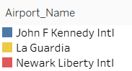
Delay Over Time By Airport
Newark Liberty International consistently experiences the highest delay percentages, with December and July showing peaks at over 50%.
John F. Kennedy International and La Guardia display lower delays overall, with significant variations between summer and winter months.
Seasonal trends indicate delays are influenced by peak travel times and weather, with summer and winter months generally seeing more disruptions.

Slide 5
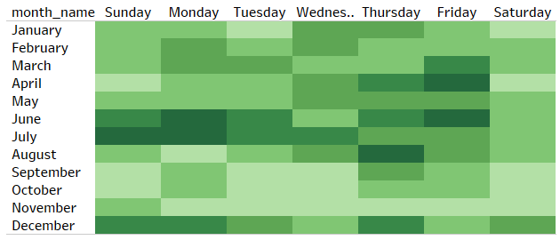
Average Delays By Day And Month
High Delays in Summer Months: Mondays and Wednesdays, with significant delays reaching over 2500 flights. This suggests higher air traffic an July experiences the highest delays, especially on d potential operational challenges during peak travel periods in the summer.
Consistently High Delays on Fridays and Sundays: Fridays and Sundays show consistently high delay numbers across various months, indicating that these days might experience traffic surges or operational inefficiencies. This pattern is particularly evident in August and December, which also correlate with higher holiday-related travel

Slide 6
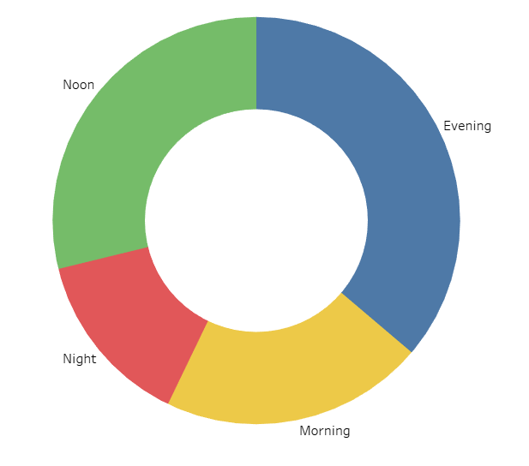

Delays By Time Of Day
Time of Day and Flight Delays: Evening flights experience the longest delays on average (49 minutes), followed by noon flights at 39 minutes. Morning and night flights show comparatively shorter delays, with night flights being the least delayed overall, suggesting that timing during the day could affect the likelihood and duration of delays.

Slide 7
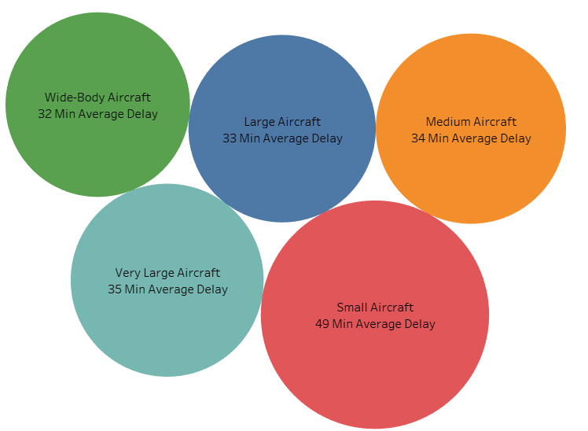
Aircraft Size
Aircraft Size and Delays: The assumption was that larger aircraft, due to their size and capacity, would face more complex operations and delays. However, the data shows that aircraft size does not significantly impact delays, with smaller aircraft experiencing the highest average delays, suggesting that other operational factors play a more significant role.

Slide 8
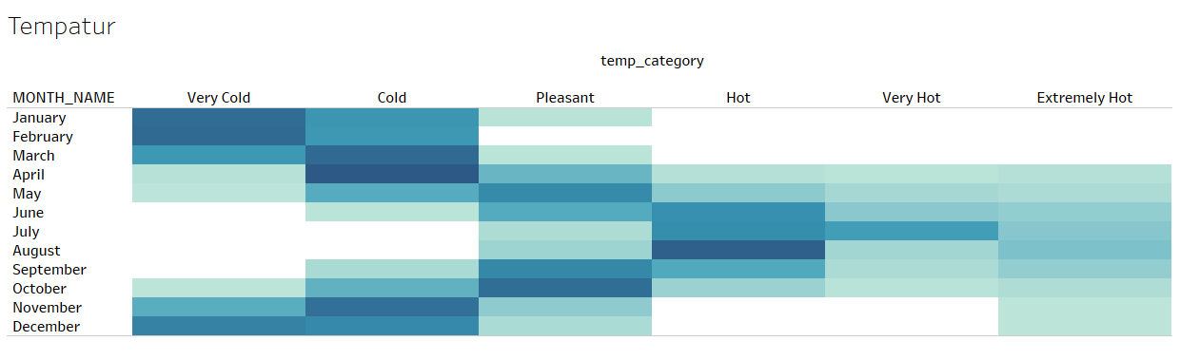
Delays By Temperature Categories
The majority of flight delays occur in cold and very cold conditions due to the freezing of aircraft components. In these temperatures, critical parts of the plane, such as the wings and engines, must be thawed using special machines, and the runway also requires de-icing to ensure safe takeoff. This process adds considerable time to flight operations, leading to delays.

Slide 9
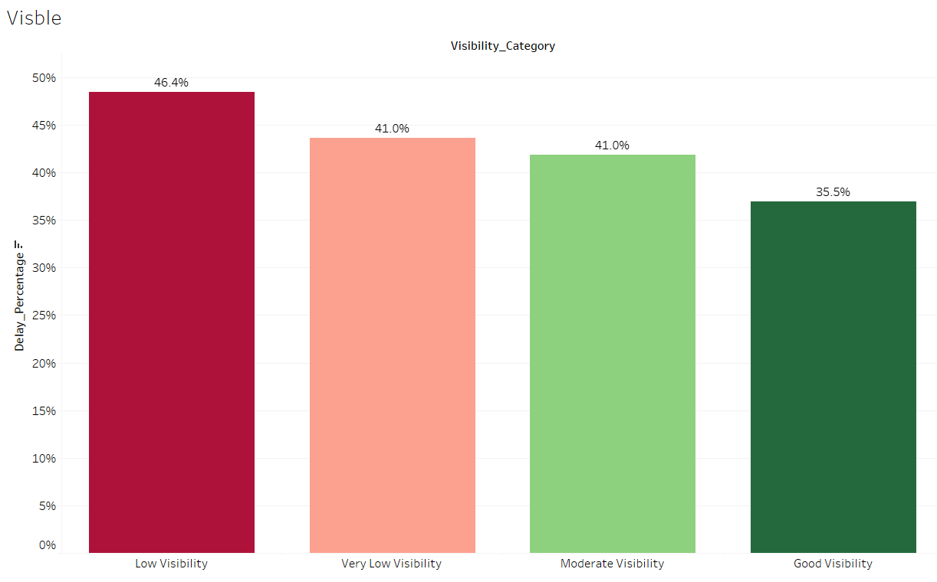
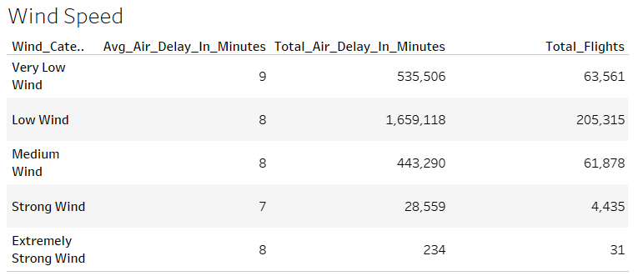
Weather Impact On Delay
Visibility
Wind Strength
25%

Slide 10



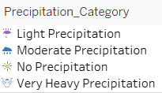
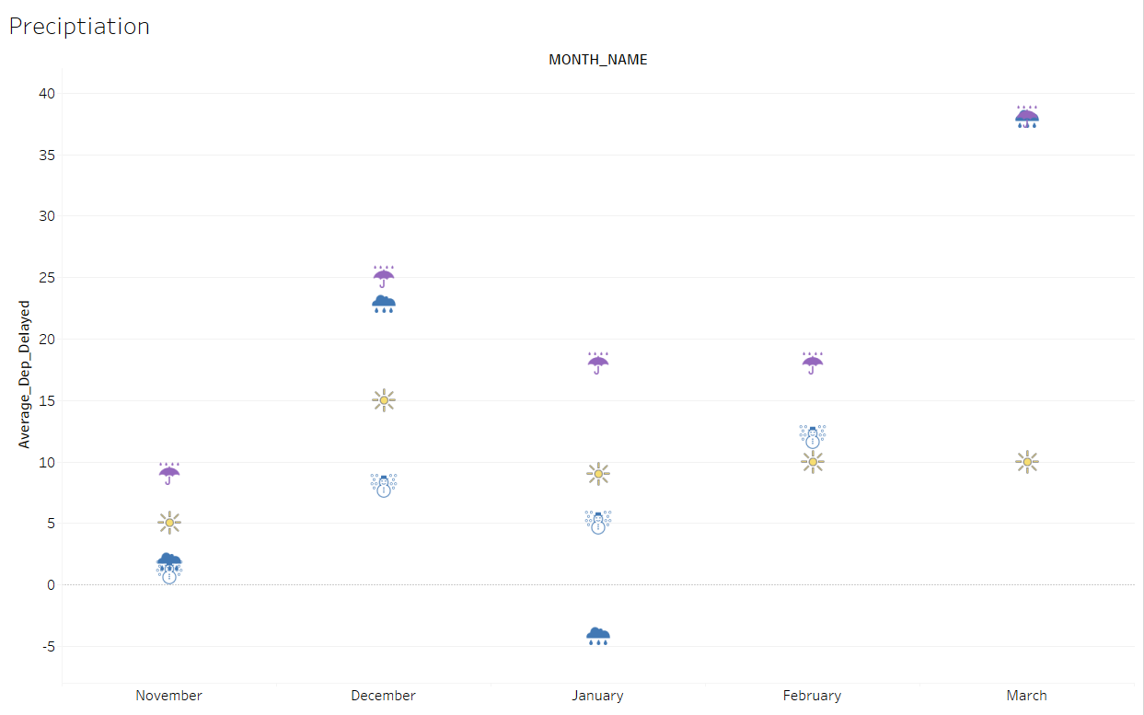
Precipitation Effects (Nov-Mar)

Slide 11
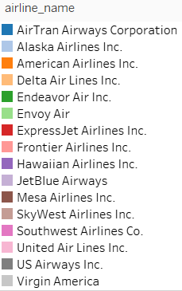
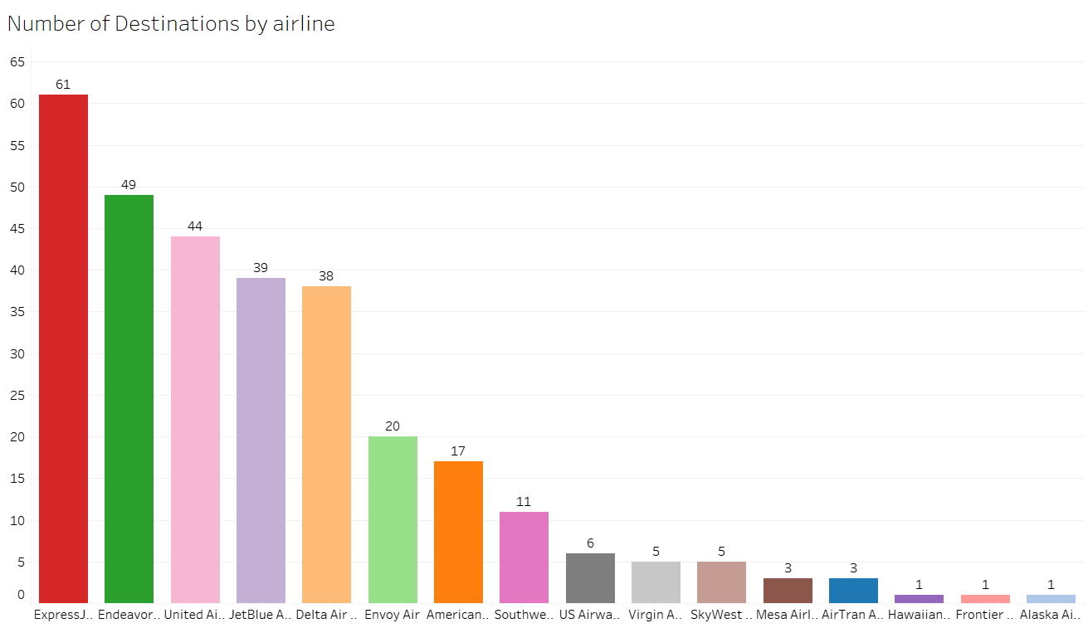
Two ideas
Mercury
Venus
Airline Destinations
Mercury is the closest planet to the Sun and the smallest one in the Solar System—it’s only a bit larger than the Moon
Venus has a beautiful name and is the second planet from the Sun. It’s hot and has a very poisonous atmosphere

Slide 12
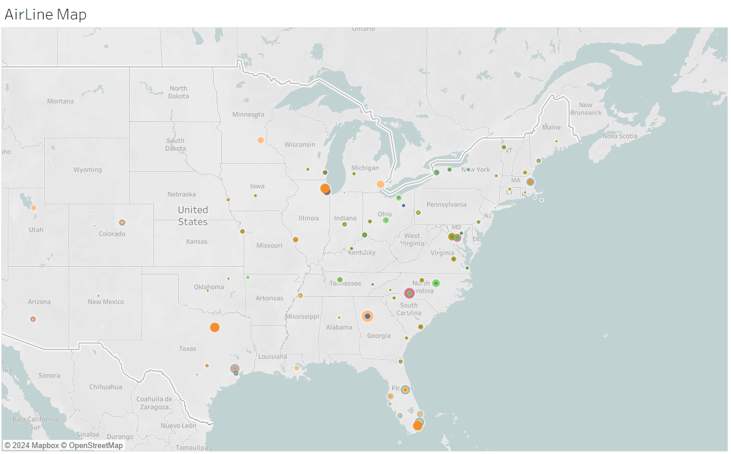
Flights Map By Airlines

Slide 13
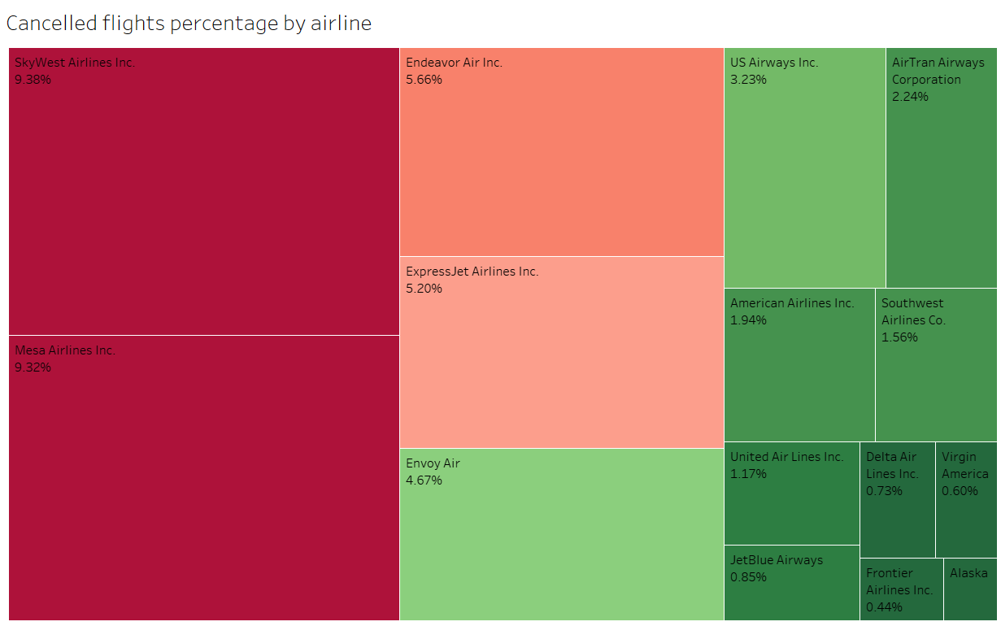
Airline Cancellation Rates
The cancellation rates vary widely across airlines, with SkyWest Airlines Inc. having the highest cancellation rate at 9.38%, although it only had 3 cancellations. In contrast, Hawaiian Airlines Inc. reported no cancellations. It's important to consider the total number of flights for each airline, as companies like SkyWest have a high cancellation rate due to their smaller volume of flights, while larger airlines like JetBlue and United Air Lines generally have lower cancellation rates despite their larger flight numbers.

Slide 14
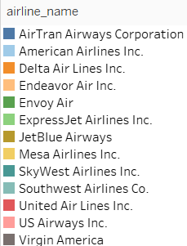
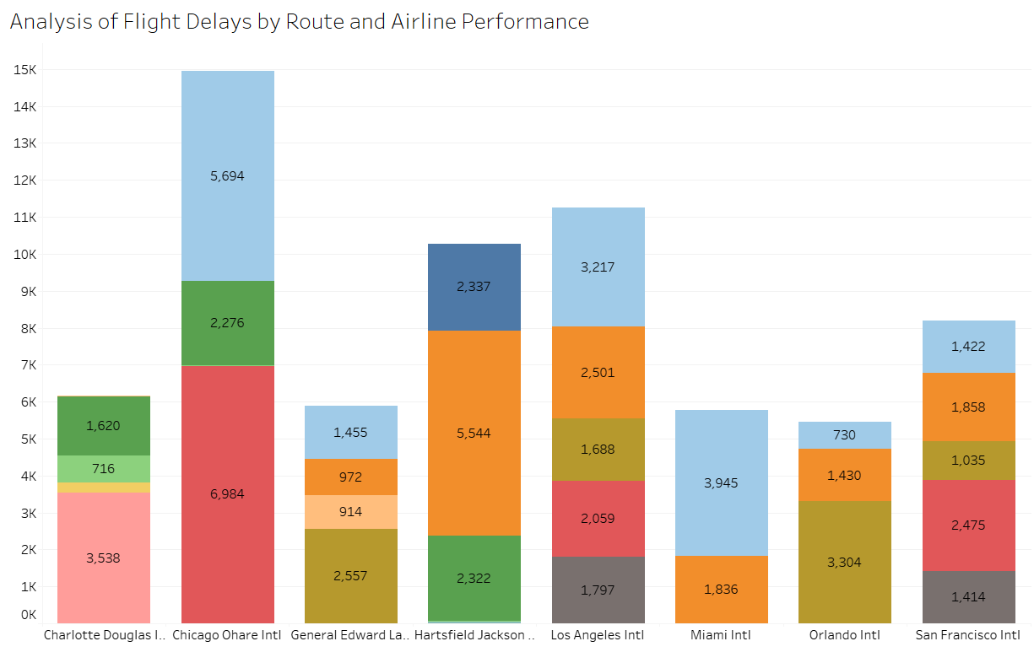
Delays By Destination & Airlines

Slide 15
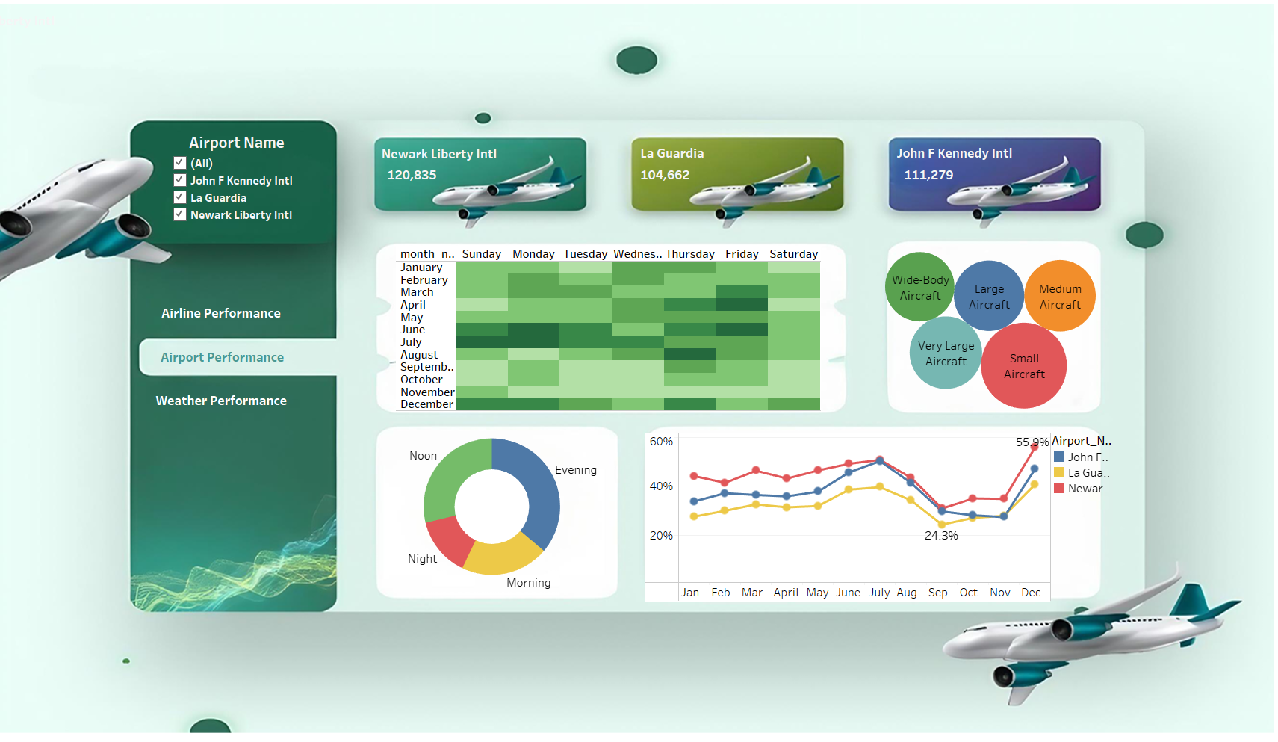

Slide 16
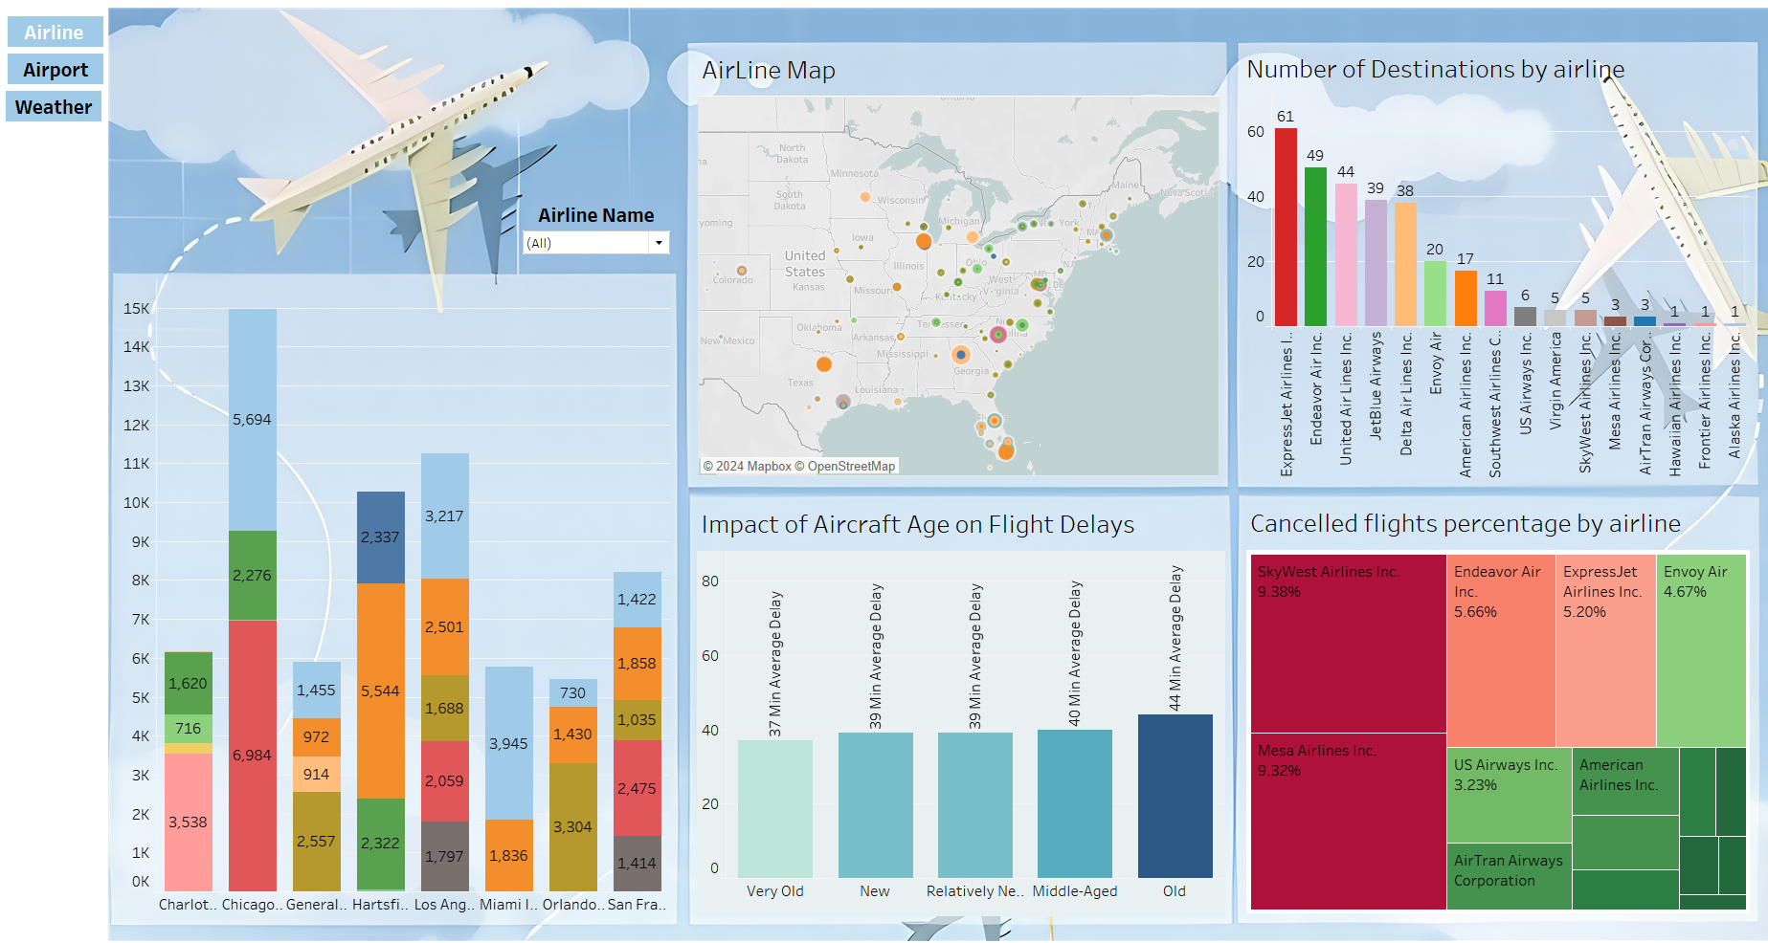

Slide 17
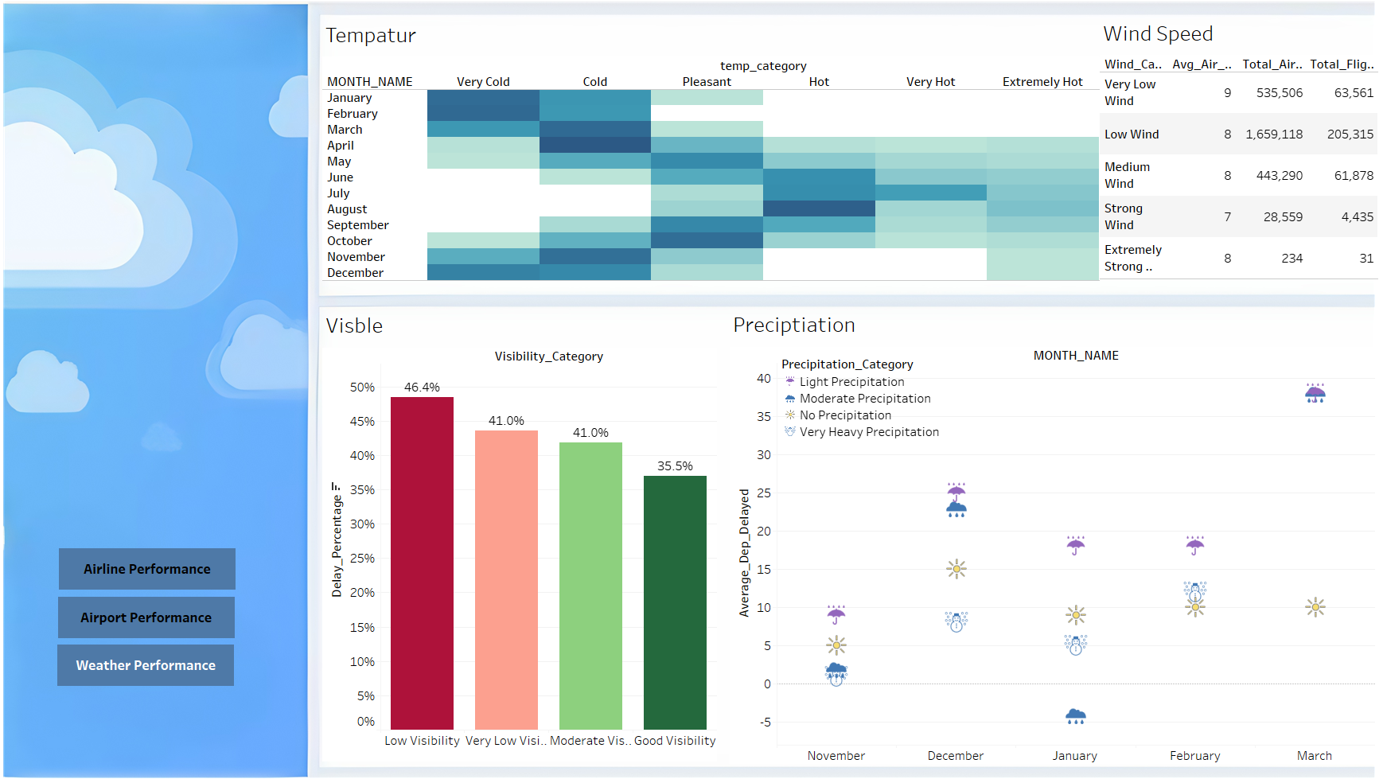

Slide 18
Key Insights: Airport Operations Performance
Yearly Averages
Time Of Day
Seasonal Trends
Aircraft Size
Throughout 2013, Newark (EWR) had the highest average delays, followed by JFK and LaGuardia (LGA), respectively.
Afternoon and evening flights recorded the highest average delays compared to the morning and nighttime.
No direct correlation was found between aircraft size and average flight delays. Larger planes did not consistently experience higher delays.
July was identified as the month with the most delays, particularly on Sundays and Mondays.

Slide 19
Key Insights: Weather Performance
Temperature
Visibility
Wind Strength
Precipitation
A direct correlation was found between low temperatures and departure delays. Extremely cold conditions can cause aircraft components and runways to freeze, requiring de-icing procedures and additional runway preparation time.
Poor visibility during flights is directly linked to increased arrival delays. The worse the visibility, the higher the likelihood of flight disruptions.
No significant relationship was identified between wind speed and flight delays.
Similarly, no direct correlation was observed between precipitation levels and delays.

Slide 20
Key Insights: Airlines Performance
Averagr Delay
Cancellation Rates
Destinations
Aircraft Age
The average delay caused by airlines is approximately 15 minutes, compared to the 40-minute average delay associated with airport operations. This indicates that airline-related delays have a relatively minor impact, with airport operations being the primary cause of flight disruptions.
A few airlines showed high cancellation rates, reaching approximately 9%.
The number of destinations operated by an airline does not influence flight delays or cancellations.
No relationship was found between the age of an aircraft and flight delays.

Slide 21
Recommendations
Airport Operations:
Weather Preparedness:
Airlines Performance
Focus on peak hour management (afternoons and evenings) with additional staff and optimized gate assignments.
Improve operations at Newark, which had the highest delays in 2013.
Enhance readiness for high-traffic periods, especially July, focusing on Sundays and Mondays.
Invest in advanced de-icing equipment and streamline cold-weather protocols.
Improve visibility tools like Instrument Landing Systems (ILS) to mitigate delays during poor weather.
Collaborate with airlines with high cancellation rates (~9%) to improve operational reliability.
Promote better communication between airlines and airport management to reduce shared delay factors.
Future Data Collection:
Include reasons for delays and cancellations for deeper analysis.
Gather data on passenger traffic and aircraft utilization to identify operational bottlenecks.

Slide 22
A/B Testing
Chosen KPI
Assumptions
Planned Experiment
Expected Impact
Previous data indicates significant delays at specific times of day across certain airports.
The experimental (test) and control groups will be equal in all parameters, except for the variable being manipulated (flight times).
There will be no interfering variables in the system.
Modify flight schedules (e.g., by adjusting times to spread out peak congestion) to see if delays can be reduced.
The experiment will focus on a specific airport or group of airports, examining the impact of different times of day on delays.
The hypothesis is that adjusting flight times will reduce overall delays.
Positive results would lead to implementing adjusted flight schedules to alleviate congestion at airports.

Slide 23
Thanks!

